Slide 1
Consumer attitudes
Lesson -9-

Slide 2
To gain insights into changing consumer behaviours., ten consumer dimensions have been identified:
Connected consumers, who constantly check emails and use the internet.
Social consumers, who use social media to connect with family, friends, companies and institutions.
Co-productive consumers, who provide feedback and co-design products for companies.
Individual consumers, who prefer customized offerings to express individual uniqueness and personality.
Experiential consumers, who also seek non-digital experiences such as live events and travelling.
Resourceful consumers, who engage in online auctions, selling to online communities and buying used goods online.
Disconnected consumers, who choose certain periods to disconnect from the digital world.
Communal consumers, who value social causes.
Conscientious consumers, who make their own things, buy locally, consider the environment and give away unneeded purchases.
Minimalist consumers, who reuse goods, buy second-hand products and participate in car-sharing schemes.

Slide 3
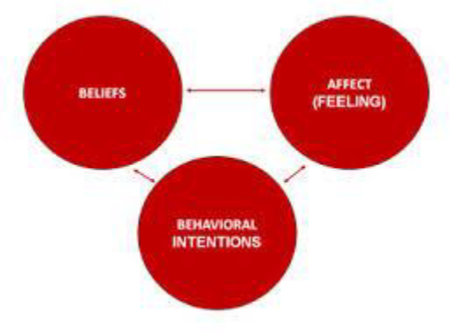
CONSUMER ATTITUDES:
Consumer attitudes are a composite of a consumer's(1) beliefs about, (2) feelings about, (3) and behavioral intentions toward some object--within the context of marketing, usually a brand or retail store. ... The first component is beliefs.

Slide 4
Beliefs:
The first component is beliefs. A consumer may hold both positive beliefs toward an object (e.g., coffee tastes good) as well as negative beliefs (e.g., coffee is easily spilled and stains papers). In addition, some beliefs may be neutral (coffee is black), and some may be differ in valance depending on the person or the situation (e.g., coffee is hot and stimulates--good on a cold morning, but not good on a hot summer evening when one wants to sleep). Note also that the beliefs that consumers hold need not be accurate (e.g., that pork contains little fat), and some beliefs may, upon closer examination, be contradictory (e.g., that a historical figure was a good person but also owned slaves).
Since a consumer holds many beliefs, it may often be difficult to get down to a “bottom line” overall belief about whether an object such as McDonald’s is overall good or bad

Slide 5
Affect:
Consumers also hold certain feelings toward brands or other objects. Sometimes these feelings are based on the beliefs (e.g., a person feels nauseated when thinking about a hamburger because of the tremendous amount of fat it contains), but there may also be feelings which are relatively independent of beliefs. For example, an extreme environmentalist may believe that cutting down trees is morally wrong, but may have positive affect toward Christmas trees because he or she unconsciously associates these trees with the experience that he or she had at Christmas as a child.

Slide 6
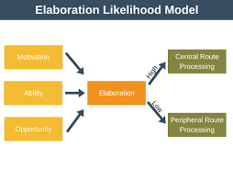

Slide 7
The Elaboration Likelihood Model (ELM) and Celebrity Endorsements:
The ELM suggests that consumers will scrutinize claims more in important situations than in unimportant ones.
The ELM posits that when a persuader presents information to an audience, a level of elaboration results. Elaboration refers to the amount of effort an audience member has to use in order to process and evaluate a message, remember it, and then accept or reject it. Specifically, the ELM has determined that when facing a message, people react by using either of two channels (but sometimes a combination of both, too), reflecting the level of effort they need. As such, they either experience high or low elaboration, and whichever of these will determine whether they use central or peripheral route processing.
If elaboration is high, then you will process the decision through your central route. If elaboration is low, you’ll process the decision through your peripheral route.
To determine which route to use, the model says that three factors determine whether your elaboration is likely to be high. These are:
Motivation
Ability
Opportunity

Slide 8
Central Route Processing
Central route processing happens when elaboration is higher. Here, the audience scrutinizes the message’s contents because of a high motivation level. They know what’s important to them. Consequently, they invest in examining the message. Using central route processing, they will carefully listen to the message and evaluate the pros and cons before making a decision. Central route processing requires conscious thought and critical thinking. To be able to process in this way, the audience must be motivated, have the ability, and the opportunity. They will also be more likely to focus and ignore distractions as they seek their goals.
Through central route processing, you can form attitudes and even beliefs. Views formed through central route processing tend to be long-lasting. When you create an attitude or view in this way, you’re less likely to change your mind about it later and more likely to behave in ways that match your new position.

Slide 9
Peripheral Route Processing
Peripheral route processing involves a low level of elaboration. The audience is not scrutinizing the message for its effectiveness. As such, other factors can influence him / her, including distractions. These include such users as those who know that they want, but do not know much about the details. For example, someone wanting a new laptop that’s good but cheap is more likely to process by the peripheral route than one who is knowledgeable about the specific features of laptops.
When one or more of motivation, ability, or opportunity is missing or low, then you’re more likely to process information via the peripheral route. Using the peripheral route you’re not consciously examining information, and you’ll often make your decision based on:
Positive or negative cues you’ve picked up
Rules of thumb
What you’ve seen others do

Slide 10
In essence, you’re trying to decide without investing any real thinking time.
Peripheral route processing is essential because you simply don’t have time to consider every decision you make carefully. By making the minor decisions on auto-pilot using peripheral processing, you free up more time to think about the more significant decisions you need to make.
Because you haven’t invested any real effort into the decision making processes, you don’t cling to attitudes formed using this route as strongly as you would if the central route had created those attitudes.
Note that the two routes are not binary options, we can use both at the same time. Sometimes we might mostly use central route processing with a little bit of peripheral route processing. Sometimes we might mostly use Peripheral route processing with a little bit of central route processing. Both exist on a sliding scale.

Slide 11
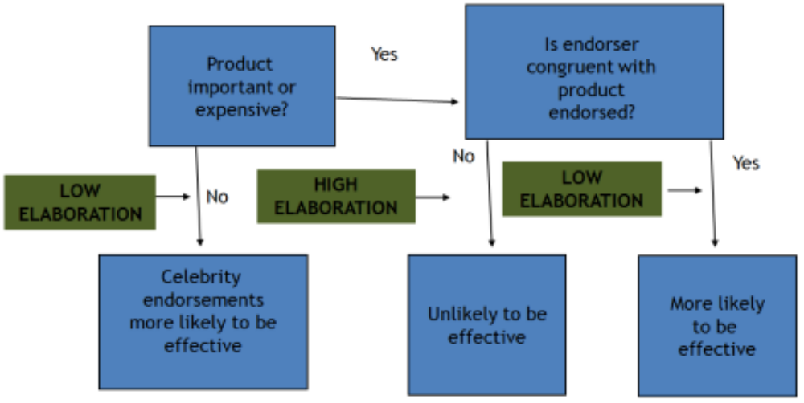

Slide 12
The ELM suggests that for “unimportant” products, elaboration will be low, and thus Bill Cosby is able to endorse Coke and Jell-O without having any special credentials to do so. However, for products which are either expensive or important for some other reason (e.g., a pain reliever given to a child that could be harmed by using dangerous substances), elaboration is likely to be more extensive, and the endorser is expected to be “congruent,” or compatible, with the product. For example, a basket ball player is likely to be effective in endorsing athletic shoes, but not in endorsing automobiles. On the other hand, a nationally syndicated auto columnist would be successful in endorsing cars, but not athletic shoes. All of them, however, could endorse fast food restaurants effectively.

Slide 13
People have attitudes toward almost everything: religion, politics, clothes, music, food.
Attitudes put us into a frame of mind: liking or disliking an object, moving toward or away from it. They lead us to behave in a fairly consistent way toward similar objects. Because attitudes economize on energy and thought, they can be very difficult to change. As a general rule, a company is well advised to fit its product into existing attitudes rather than try to change attitudes. If beliefs and attitudes become too negative, however, more serious steps may be necessary. With a controversial ad campaign for its pizza, Domino’s took drastic measures to try to change consumer attitudes.

Slide 14
Domino’s Known more for the speed of its delivery than for the taste of its pizza, Domino’s decided to address negative perceptions head on. A major communication program featured documentary-style TV ads that opened with Domino’s employees at corporate headquarters reviewing written and videotaped focus group feedback from customers. The feedback contained biting and vicious comments, such as, “Domino’s pizza crust to me is like cardboard” and “The sauce tastes like ketchup.” After President Patrick Doyle is shown on camera stating these results were unacceptable, the ads proceeded to show Domino’s chefs and executives in their test kitchens proclaiming that its pizza was new and improved with a bolder, richer sauce; a more robust cheese combination; and an herb-and garlic-flavored crust. Many critics were stunned by the admission of the company that their number 2 ranked pizza, in effect, had been inferior for years. Others countered by noting that the new product formulation and unconventional ads were addressing a widely held, difficult-to-change negative belief that was dragging the brand down and required decisive action. Doyle summed up consumer reaction as “Most really like it, some don’t. And that’s OK.”

